Slide 1
AllJoyn Overview
Chen Xu 2015.1

Slide 2
Internet of Everything
IoE
Bring people, data, things together
Smart devices
Bottleneck?
IoE standard
ZigBee , Z-Wave Alliance
unwieldy and too heavy
Bluetooth SIG, 6LoWPAN, Insteon
failed to garner a huge following across a spectrum of products
AllJoyn

Slide 3


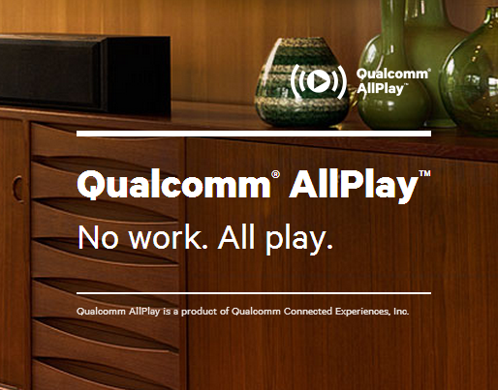
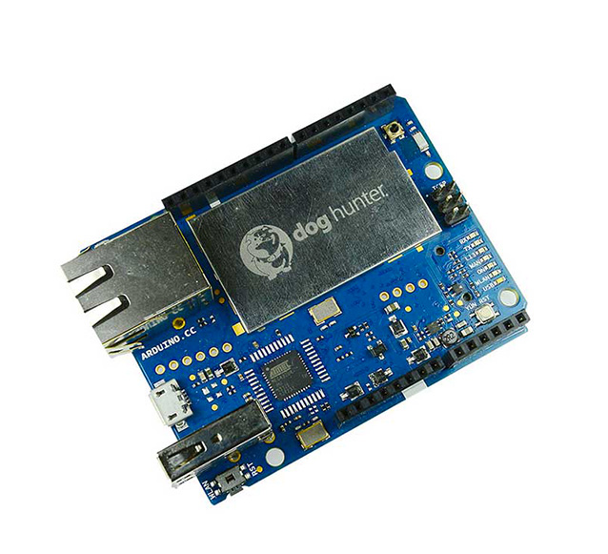







AllJoyn
Open source project initially leaded by Qualcomm in 2011
Source code singnd over to Linux Foundation. The AllSeen Alliance is created
Show cases
Success is hard to say

Slide 4
IoE Competitors and Advantage
Thread (2014.7)
Thread Group - Nest, Google, Samsung
IPv6
802.15.4
Security and low power
Home Kit (2014.8)
Apple
The inter-action between things must via apple
IoTivity (2014.7)
Open Interconnect Consortium - Intel, Cisco, GE
Internal
Baidu Inside plan, Jingdong Plan
Ali MICO: smart hardware os

Slide 5
Advantage
The most manufacturers
Open source
Easy To Use
Handles underlying complexities, provides simple-to-use API
Providing common services
Flexible
Transports: Wi-Fi, Ethernet, Power Line(PLC)
Binding: C, C++, Objective C, Java
Platforms: RTOS, Arduino, Linux, Android, iOS, Windows, Mac OS X
Additional cloud service
Gateway agent

Slide 6
What is AllJoyn
A way devices and applications publish APIs over a network in a standard way
Why APIs?
Because this is what software developers understand and work with every day
These APIs are the functionality that the “things” on the network expose to other “things”
E.g. temperature, time of day, etc….
Services and/or devices can compose the APIs to provide whatever set of functionality they require
The APIs are critical to interoperability between devices and services
How do applications know what APIs are available?
AllJoyn provides application discovery and fine-grained discovery of APIs supported by applications

Slide 7
AllJoyn Overview
AllJoyn implements a “distributed software bus”
The bus provides the medium that enables AllJoyn to communicate via published APIs
Applications can be firmware on microcontrollers, mobile device “apps”, or traditional applications on PCs/servers
Applications publishing APIs are services, while those consuming the APIs are clients
An application can be both a service and a client: this makes AllJoyn a peer-to-peer system
Communications is via messages that map directly to APIs in high-level programming languages
Bus information is ad hoc
Based on discovery of applications/services
Protocol is network-independent
Wire protocol is based on the D-Bus wire-protocol with extensions
D-Bus is a message bus system for a inter-process communication on same machine
AllJoyn extend and significantly enhance D-Bus message bus to support a distributed bus scenario
Can run over Wi-Fi, Ethernet, PLC and Bluetooth
Could likely run over others

Slide 8
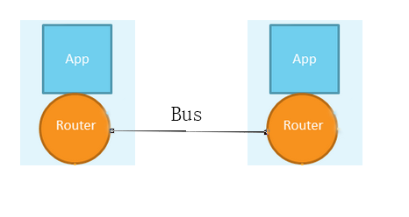
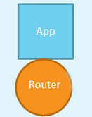
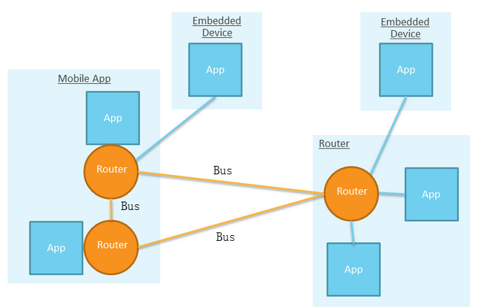
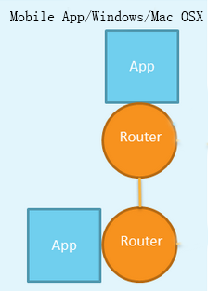
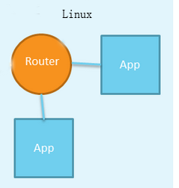
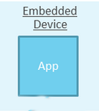
How to communicate
AllJoyn Framwork comprises two parts
Application
Router
routes AllJoyn messages between Alljoyn applications
On different platforms, the relationship between application and router is different
From AllJoyn perspective, it doesn’t matter.

Slide 9
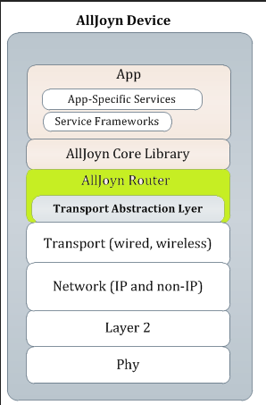
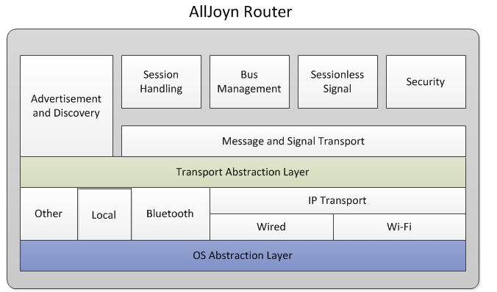
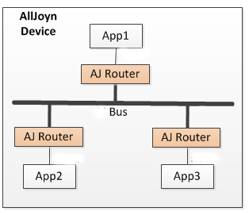
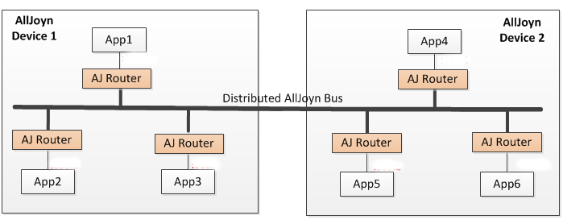
AllJoyn Router
Do the heavy lifting in the AllJoyn system
Provides an abstraction layer for each of the supported transport
The Router functionality
Application Addressing over the bus
Cross-device communication: discovering services and connecting to its router
Delivering messages between applications

Slide 10
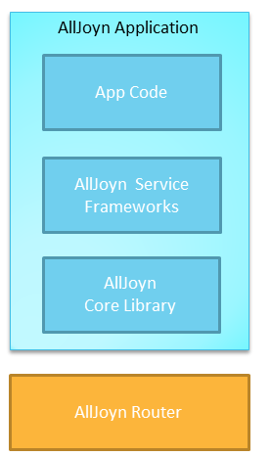
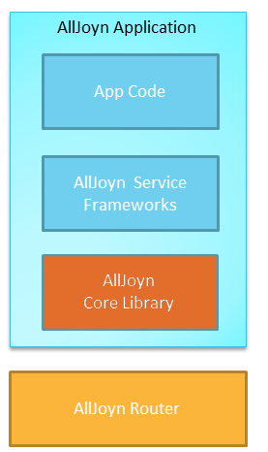
AllJoyn Application
What’s in a AllJoyn Application?
AllJoyn Core Library
Provides the lowest level set of API to interact with AllJoyn network
AllJoyn Service Framwork Libraries
Implement a set of common service
AllJoyn App Code
Application logic. Can be programeed to either Service Framework or Core Library.

Slide 11
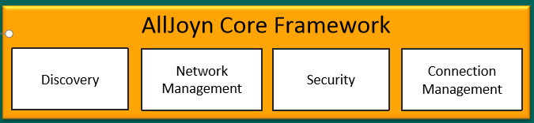
Core library
The API set of the AllJoyn SDK
Two implementations
Stand: targeting at applications running in Windows, Linux, iOS, Android, Mac
The SDK APIs for the SC provide a high level of abstraction, and allow complex multi-threaded applications
Implemented in C++ and there are a number of language bindings for various platforms available
Seamless interoperability between applications written in different languages
Thin: targeting at applications that reside on embedded devices
Not enough resource, i.e. CPU, memory
Implemented in C, with no other language bindings
Thin core library depends on a router running elsewhere

Slide 12
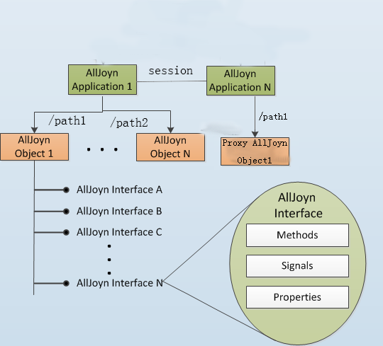
Exposing Functionality
AllJoyn applications expose their functionality via APIs implemented in objects
Most applications will expose only a single object
Objects implement one or more interfaces
These are the APIs that can be discovered using About
Interfaces are composed of members, which fall into 3 categories
Methods: classic OO object interaction
Signals: asynchronous event notification
Can be broadcast, multicast, or point-to-point
Properties
Accessed by built-in get/set methods
Applications register objects on specific path

Slide 13
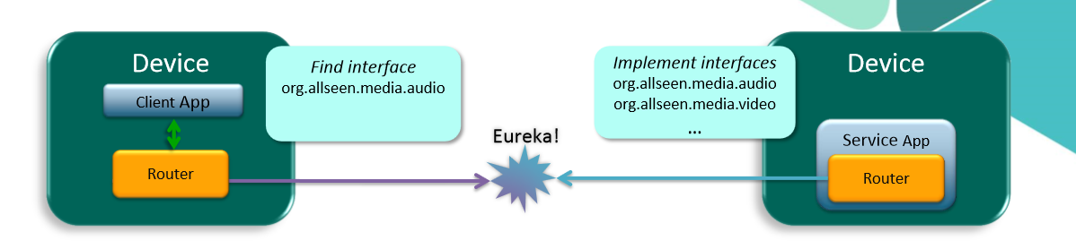
Discovery
Interface descriptions contained in About message
About message also contains metadata
App icon
Device Name
Language English or Chinese
Port (used to create session)

Slide 14
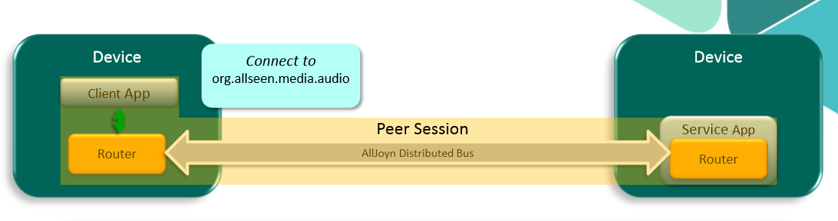
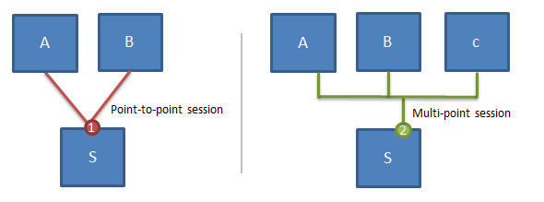
Connect
B requests to make a session with A
A has the option of accepting it or not
Create a session with A on some port
Session can be point to point or multi-point

Slide 15
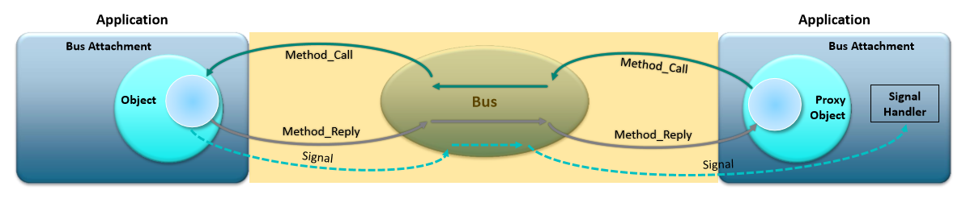
Interact
Method calls and signals
Method calls are made by using Proxy Objects
Proxy Objects: local representation of a remote object
This results in a method call message being sent to the object the proxy object represents
Method handler is invoked to execute method and generate the reply
The method reply is sent back to the proxy object
Signals are emitted by objects and consumed by Signal Handlers
Signal handler: take action when a signal is received

Slide 16
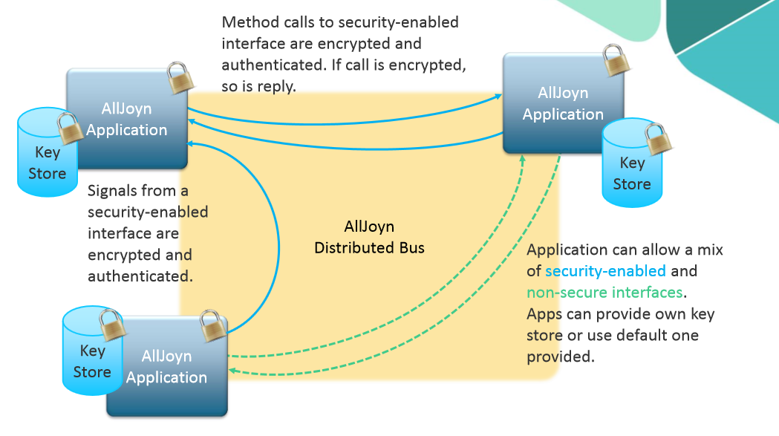
Session less Signal and Security
Sessionless signal
Broadcast and delivered to any app interested in receiving session-less signals
Receive signals without having to manully creating a session
Security
App-to-app
There is no trust relationship established at device level
If required, authencation occurs on demand between two apps when a method is invoked or a signal is emmited
Multi authenitication mechanism
PIN code
PSK
ECDSA
After authenticated, messages between two devices are encrypted using AES-128 CMM algotithm

Slide 17
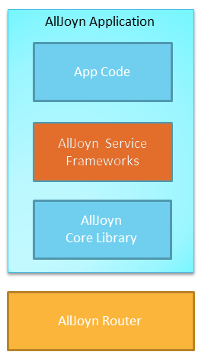
AllJoyn Service Framework
Sit on top of AllJoyn core library
Provides some of the core and fundamental functionality
Provide API to application developers to invoke their functionality
Aiming to create a eco-system
Including
Onboarding Service
Configuration Service
Notification Service
ControlPanle Service
To be expanded

Slide 18
AllJoyn Service(1) - OnboardService
Onbarding service
Provides a standard way to get devices onto a Wi-Fi network
Especially for devices that have a limited user interface, like a smart plug
Case
Onboardee: a smart-plug
Onboarder: an application running on a smart device
Basic flow
The smart-plug provides Access Point(AP) and advertises it
The application discovers it, connects to it
The application provides it with Wi-Fi credentials
The refrigator connect to the Wi-Fi

Slide 19
AllJoyn Service(2) – Configuration
Configuration Service
Provide the ability to configure a device
Configure what?
Device name and default language
Factory reset
Set password
Even restart

Slide 20
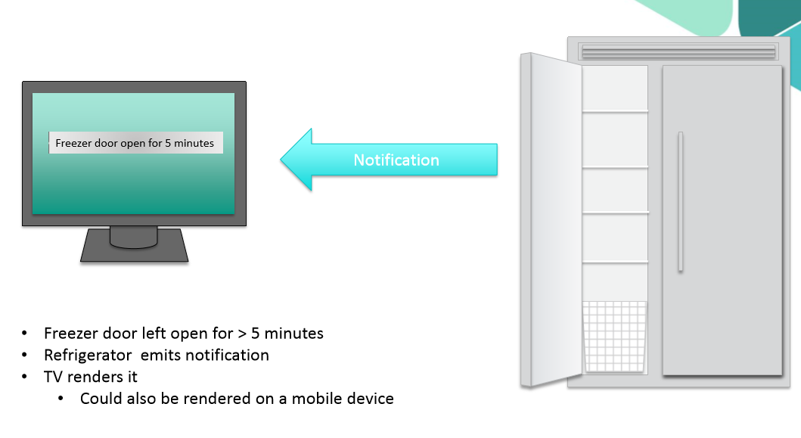
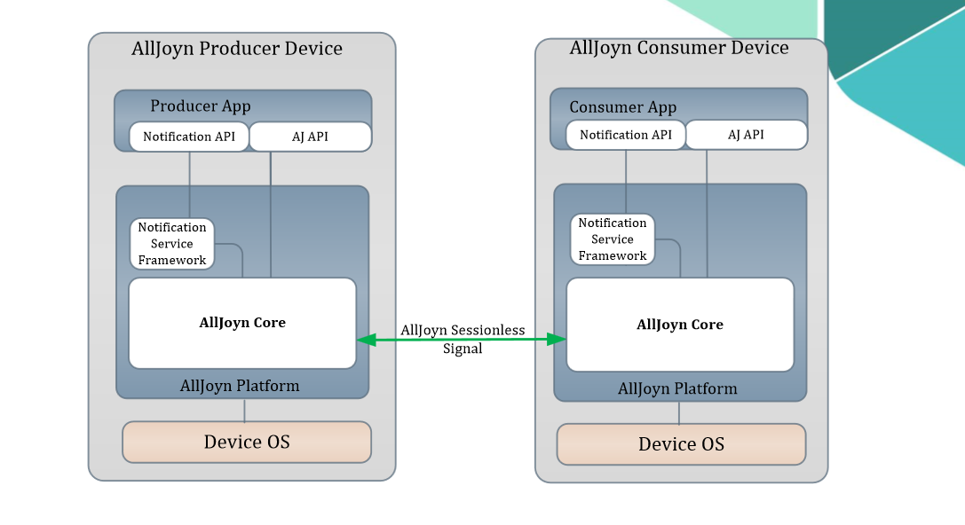
AllJoyn Service(3) –Notification
Notification Service
Allow human-readable messages to be sent and received by devices
Contents are text
Possible to reference image, audio, video via URL
Receivers decide how to display or render notification
Examples
Refrigerator could send a notification that freezer door has been left open for more than 2 minutes
This could be rendered on any producer: mobile device, TV, etc…
Washing machine can send a notification when wash cycle is complete

Slide 21
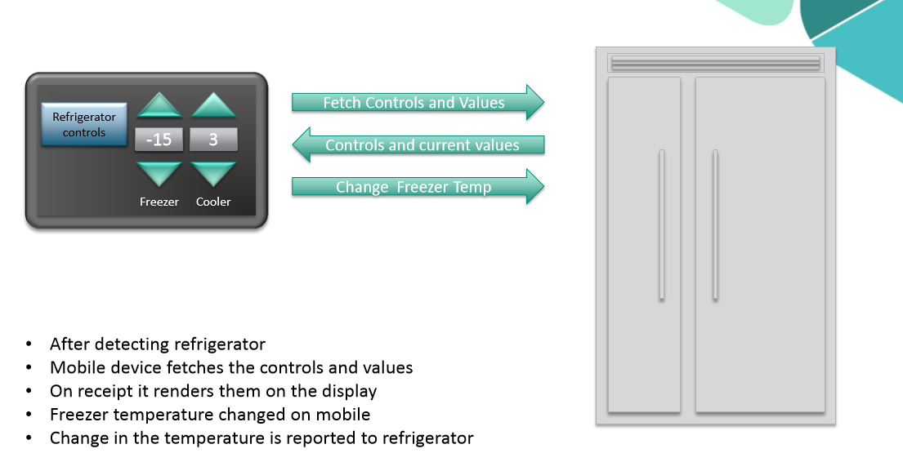
AllJoyn Service(4) -ControlPanel
Exposing user interfaces for device remotely
Model is there is a controller and a controlee
Controlee exposes its UI using the framework
Controller renders UI and sends control commands back to controlee base on UI input
So that any control application using the framework can render a controlee exposed UI
Examples
A user could check the current values of a refrigerator(including current temperature) and modify the settings to make things hotter or colder as needed

Slide 22
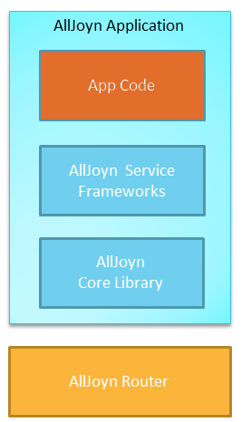
Application
All kinds. App-specific to achieve desired functionality
Sit on top of AllJoyn framework service
Programming
Using AllJoyn Service Framework API
To be compatible with devices in the AllSeen ecosystem
Using AllJoyn Core API
Implement own service
Can use both sibe by side

Slide 23
Demo

Slide 24
Q&A

